Slide 1

Great Energy Predictor
Team: High on Data
Members: Anisha Alluru, Apoorva Jasti, Aurangzaib Ahmed Siddiqui,
Manas Rai, Vishal Ramachandran

Slide 2
Agenda
Project Overview
Data Description and Handling
Exploratory Data Analysis
Modeling and Prediction
Recommendations and Conclusion

Slide 3
Project Description
Background
Today, significant investments are being made to improve building efficiencies but owners makes payments based on the difference between their real energy consumption and what they would have used without any retrofits. The latter values come from a model.
Objective
We have chosen a kaggle case competition focusing on building accurate models of metered building energy usage provided by ASHRAE, an institute that serves to advance the arts and sciences of heating, ventilation, air conditioning, refrigeration and their allied fields.
https://www.kaggle.com/c/ashrae-energy-prediction/data
Notes:
How many units of electricity is UT Tower going to consume next year?
Q: How much does it cost to cool a skyscraper in the summer?
A: A lot! And not just in dollars, but in environmental impact.
Thankfully, significant investments are being made to improve building efficiencies to reduce costs and emissions. The question is, are the improvements working? That’s where you come in. Under pay-for-performance financing, the building owner makes payments based on the difference between their real energy consumption and what they would have used without any retrofits. The latter values have to come from a model.

Slide 4





Technology Stack

Slide 5
Data Description
Data collected over 3 years across 16 sites for around 1500 buildings.
Building metadata
Floor count, area, age, primary use, site, etc.
Weather data
Site level hourly data of temperature, wind speed, precipitation, cloud coverage
Meter Readings
Building level hourly data of energy consumption readings collected from 4 different meters
20 million training data points and 40 million test data points

Slide 6

60 million data points - Databricks & Colab were like

Slide 7
Data Size Reduction
60 million data points - Around 8 GBs of data before feature engineering
Reduced data size by almost 50%
int64 -> int32 and int16
float64 > float32 and float16
Removed columns with >70% nulls
Label Encoding categorical features to int8

Slide 8
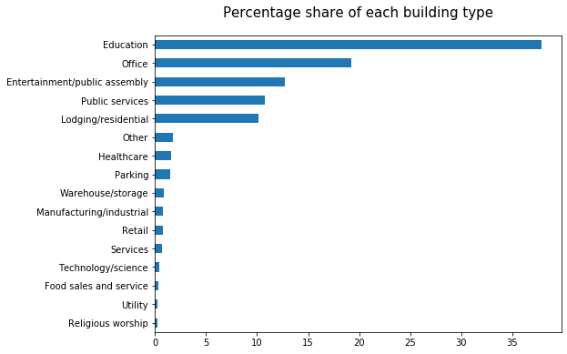
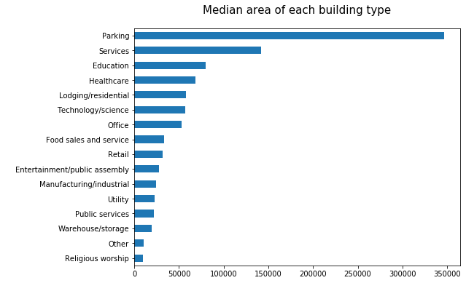
Educational buildings have maximum presence while Parking takes the most space

Slide 9
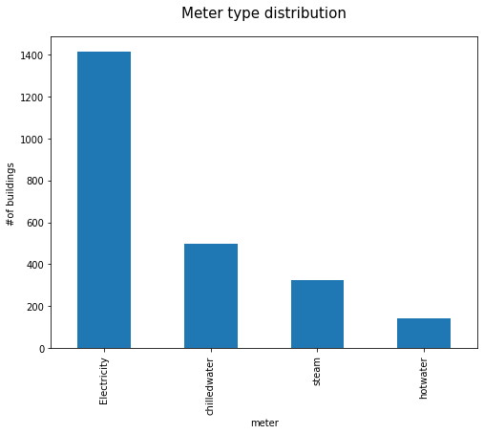
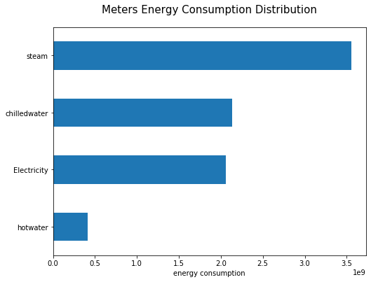
Electricity meter is omnipresent while Steam consumes the most energy

Slide 10
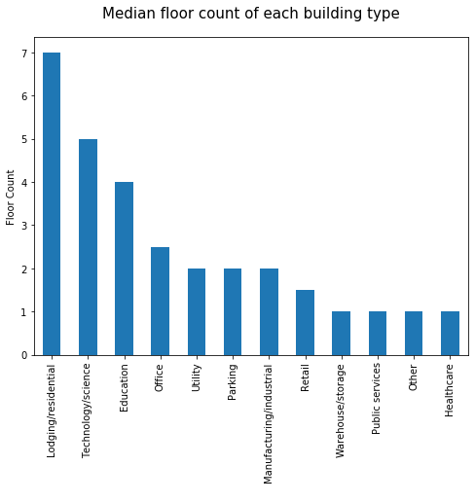
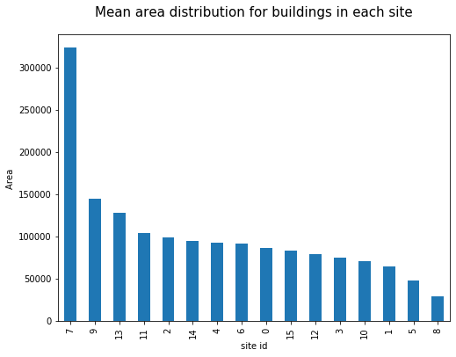
Residential/Lodging are tallest & Site 7 has more spread buildings

Slide 11
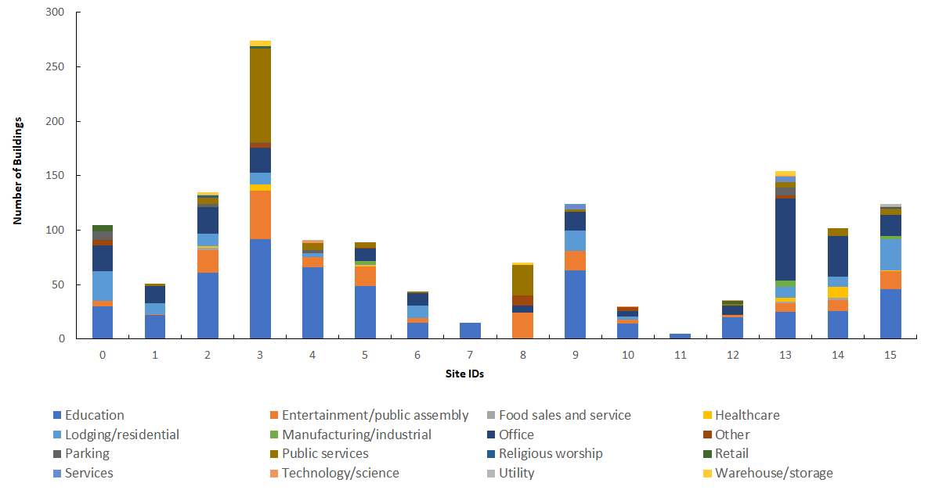


Sites 7 & 11 predominantly have educational buildings while Site 13 mostly has office buildings

Slide 12
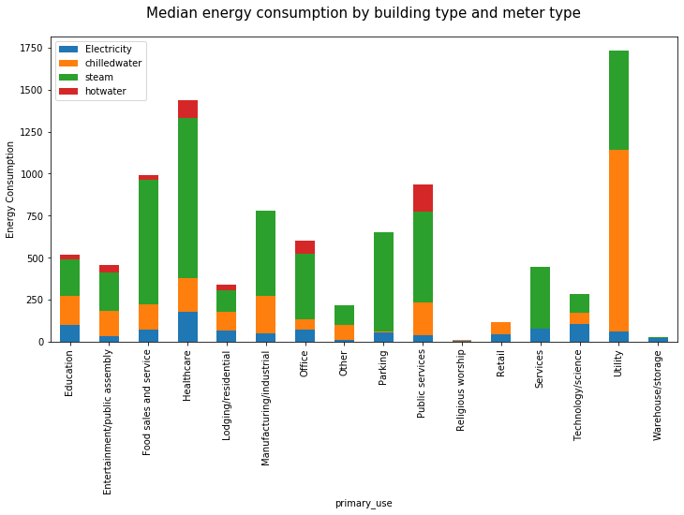
Chilled water was the most consumed energy in utility buildings

Slide 13
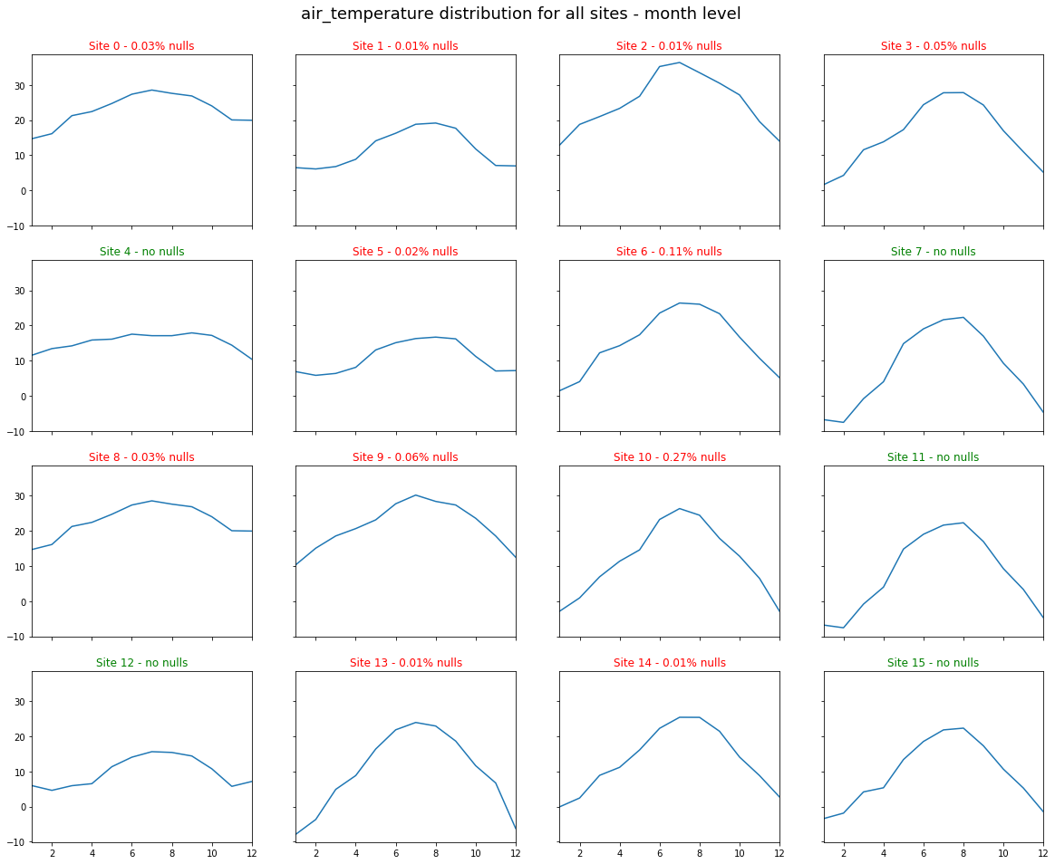
Monthly Weather patterns (Air Temperature) across Sites
Notes:
We can see that that the weather patterns are different across most sites as the data is taken across vast areas of lands such as different states affecting the energy consumption. Some sites have similar weather patterns but different energy consumption

Slide 14
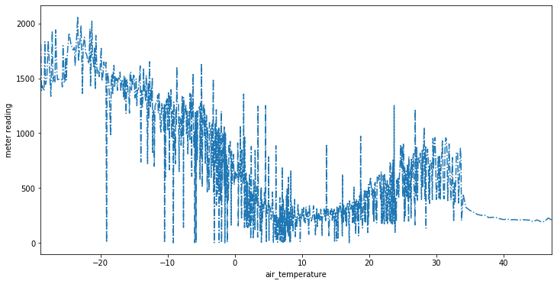
Air Temperature is a good indicator of energy consumption

Slide 15
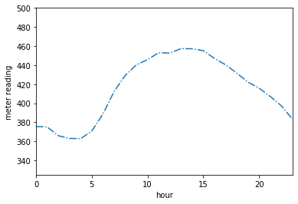
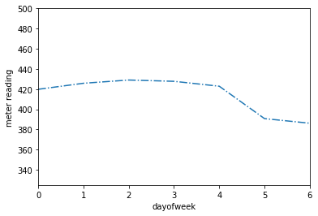
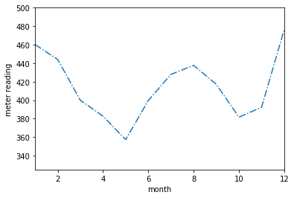
Time Series Analysis of Energy Consumption
Hour of the Day | Day of the Week | Month of the Year
Higher energy consumption during day time | Higher energy consumption during the weekdays | Higher energy consumption during Dec-Jan

Slide 16
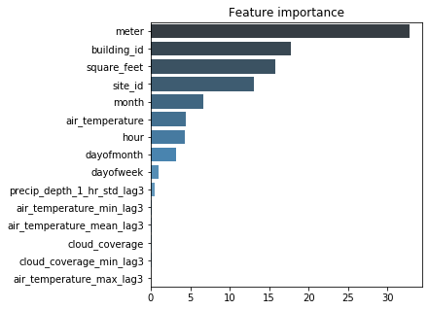
Modeling - CatBoost
Train and Validation
H1 vs H2
3 fold CV
500 boosting trees
Parameters
Learning rate: 0.05
Max depth: 8
Train Score: 0.84
Validation Score: 1.29
Test Score: 1.34

Slide 17
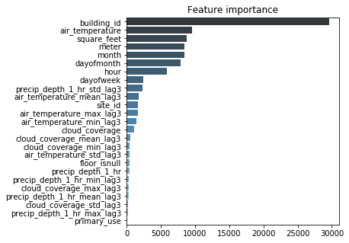
Modeling - LGBM
3 fold cross validation
Tuned Parameters
Learning rate: 0.03
Feature Fraction: 0.85
Reg Lambda: 0.2
Max depth: 10
Train Score: 0.55
Validation Score: 1.02
Test Score: 1.11 (Kaggle Top 40%)
Test Score Post-Processing: 1.01 (Kaggle Top 20%)

Slide 18
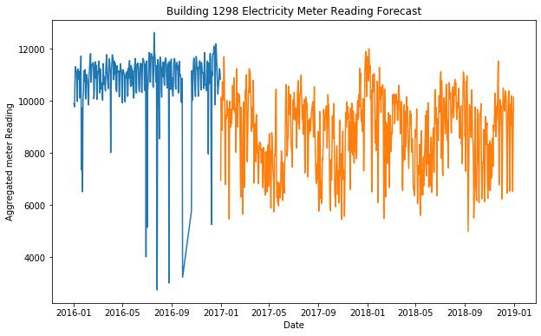
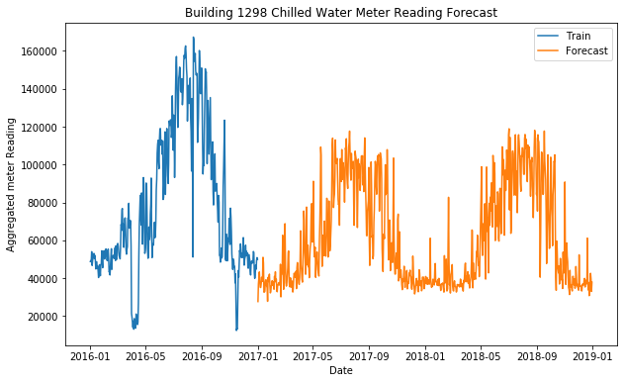
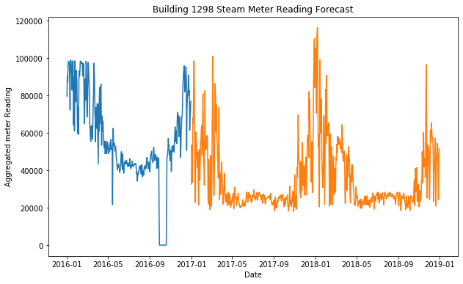
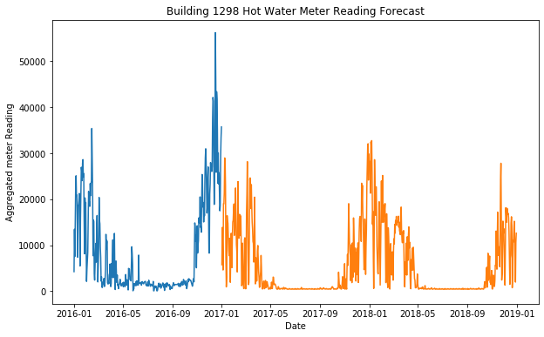
Model Prediction (for Building 1298)

Slide 19
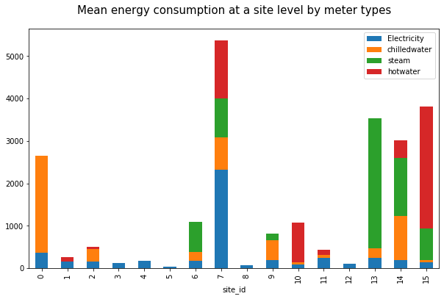


Recommendation
Insights
Site 13 consumes high amount of steam
Recommendation
Upgrade the steam equipment used in the offices in Site 13
Notes:
As we can see,
Site 13 could be cities such as Minneapolis, where there a lot of office headquarters such as 3M and Target having high steam consumption

Slide 20
Recommendation
Insights
Site 0 consumes most amount of chilled water, at least 6 times more than others
Recommendation
Upgrade the chilled water system in the educational and residential buildings
Notes:
Site 0 can be in cities in Florida - hot, humid places + rich areas where people prefer chilled water

Slide 21
Recommendation
Insights
Site 7 has the highest energy consumption across all sites
Recommendation
Upgrade all the old equipments in the educational buildings in this site
Notes:
Site 7 has the lowest amount of buildings but large amount of areas across all sites but the highest amount of consumption especially in electricity. This could be one of the educational towns in US where the buildings are pretty old and the metres haven’t been updated.

Slide 22
Next Steps
Different approaches yet to be tried:
Train for each meter
Train for each site
Try to utilize external data
Tune parameters further
Try stacking CatBoost and LGBM outputs
Try H20.ai Auto ML algorithm for benchmarking

Slide 23
Questions?

